Slide 1
What is Machine Learning?
ML is a specific subset of AI that trains machines how to learn.
Optimize a performance criterion using example data or past experience.
Role of Computer science: Efficient algorithms to
Solve the optimization problem
Representing and evaluating the model for inference.

Slide 2
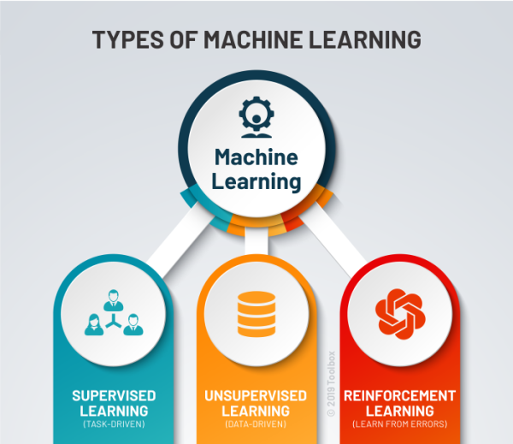
Types of Machine Learning:

Slide 3
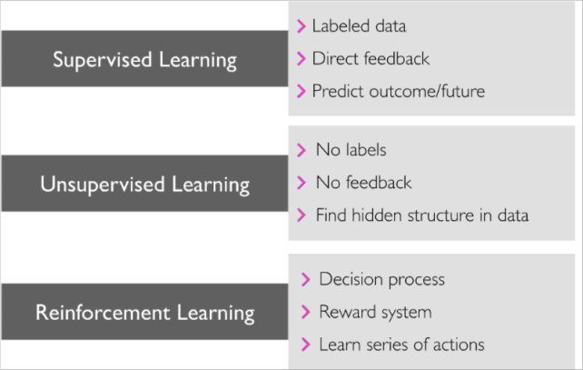

Slide 4
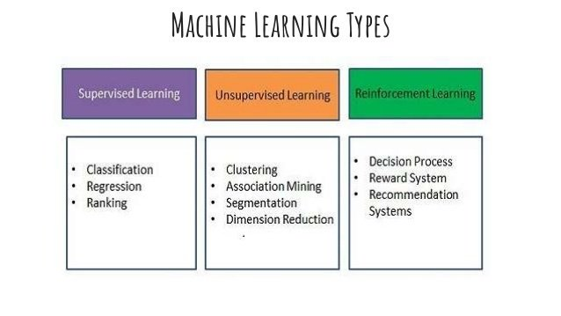

Slide 5
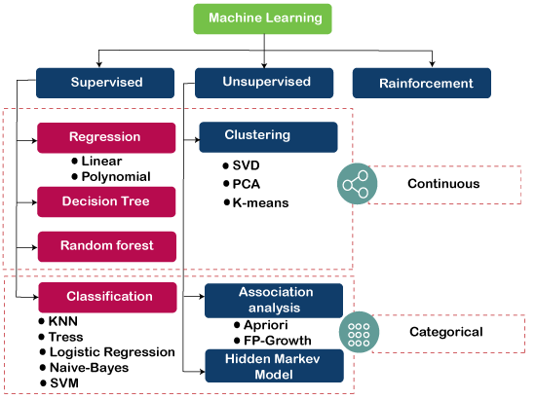

Slide 6
Supervised learning:
Supervised learning is the type of ML algorithms that require both input and output data is initially provided.
Basically, data engineers create an algorithm, then train it with a labeled dataset — the one that has actual input and output parameters.
– Given: Training data + Desired outputs (labels)

Slide 7
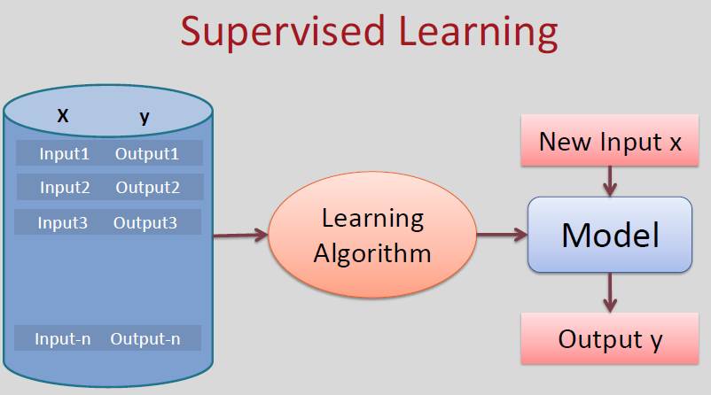

Slide 8
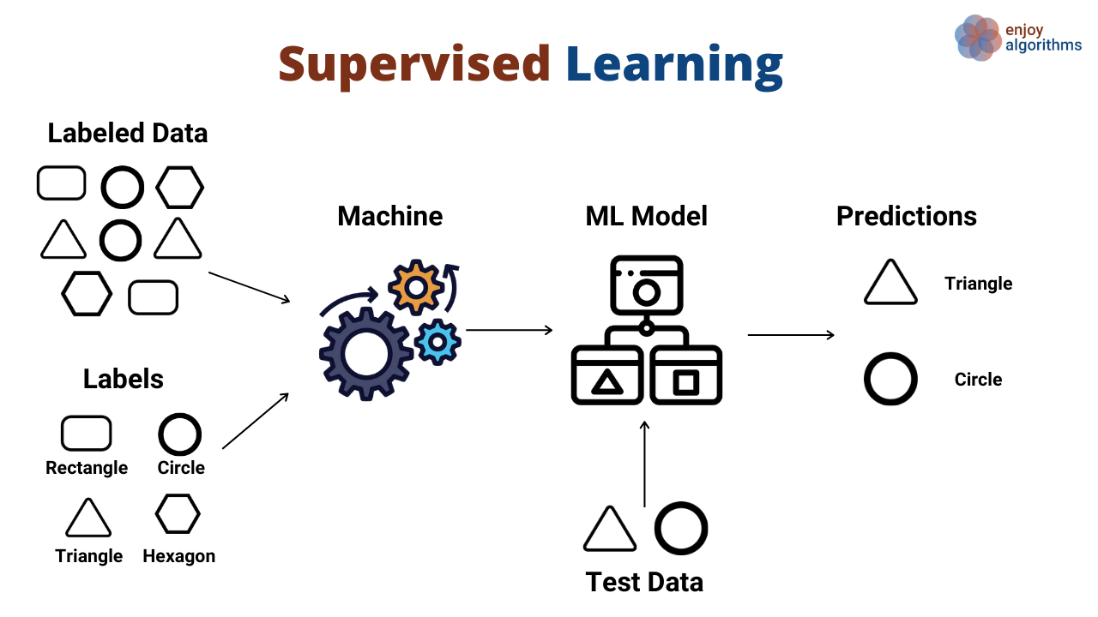

Slide 9
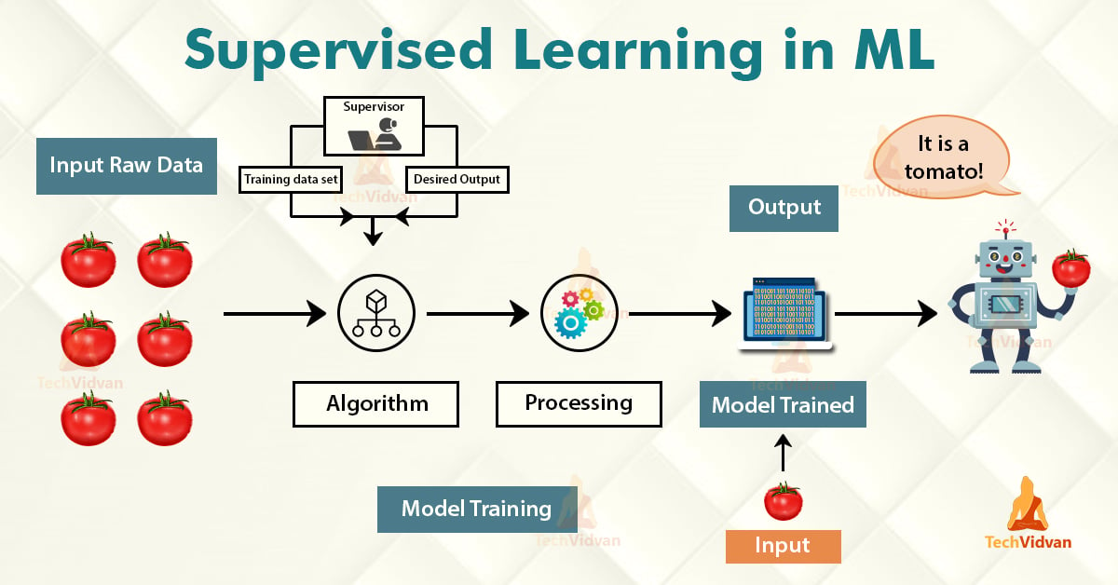

Slide 10
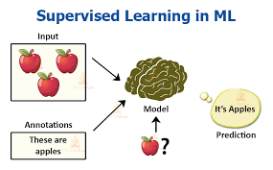

Slide 11
Unsupervised Learning:
Unsupervised learning is a type of ML algorithm which works with the input data having no examples or suggestions of the expected output.
Its primary aim is to combine/gather the data into categories.
Unsupervised learning divides into the following subtypes:
Association:- This allows discovering fascinating interconnections between portions of data in large datasets.
Clustering:- This kind of algorithm is very spread since it allows simply grouping the pieces of data according to a certain trait.
– Given: Training data (without desired outputs)

Slide 12
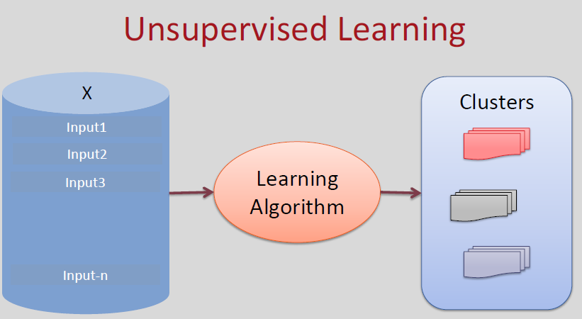

Slide 13
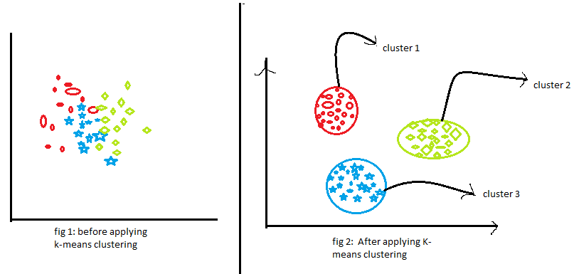
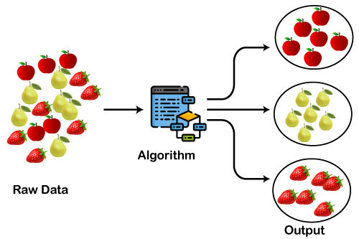

Slide 14
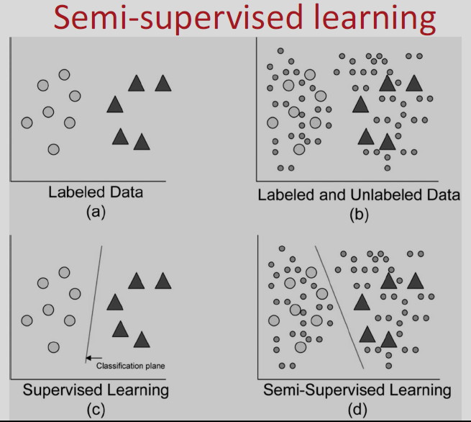
Semi-supervised learning:
– Given: Training data + a few desired outputs

Slide 15
Reinforcement Learning :
It is employed by various software and machines to find the best possible behavior or path it should take in a specific situation.
Reinforcement learning differs from supervised learning in a way that in supervised learning the training data has the answer key with it so the model is trained with the correct answer itself.
whereas in Reinforcement learning, there is no answer but the reinforcement agent decides what to do to perform the given task.
In the absence of a training dataset, it is bound to learn from its experience.

Slide 16
In reinforcement learning, the algorithm (in this context also often referred to as agent) learns through trial-and-error using feedback to its own actions.
Rewards and punishment operate as signals for desired and undesired behavior.
The best context to understand reinforcement learning is in a game with a clear objective and a point system

Slide 17

Example: The problem is as follows: We have an agent and a reward, with many hurdles in between. The agent is supposed to find the best possible path to reach the reward. The following problem explains the problem more easily.

Slide 18
The above image shows the robot, diamond, and fire.
The goal of the robot is to get the reward that is the diamond and avoid the hurdles that are fired.
The robot learns by trying all the possible paths and then choosing the path which gives him the reward with the least hurdles.
Each right step will give the robot a reward and each wrong step will subtract the reward of the robot.
The total reward will be calculated when it reaches the final reward that is the diamond.

Slide 19
Applications in self-driving cars:
Some of the autonomous driving tasks where reinforcement learning could be applied include trajectory optimization, motion planning, dynamic pathing, controller optimization, and scenario-based learning policies for highways.
For example, parking can be achieved by learning automatic parking policies.
Lane changing can be achieved using Q-Learning while overtaking can be implemented by learning an overtaking policy while avoiding collision and maintaining a steady speed thereafter.

Slide 20
Reinforcement Learning applications in trading and finance:
Supervised time series models can be used for predicting future sales as well as predicting stock prices.
However, these models don’t determine the action to take at a particular stock price.
Enter Reinforcement Learning (RL). An RL agent can decide on such a task; whether to hold, buy, or sell.
The RL model is evaluated using market benchmark standards in order to ensure that it’s performing optimally.

Slide 21
Main points in Reinforcement learning –
Input: The input should be an initial state from which the model will start
Output: There are many possible outputs as there are a variety of solutions to a particular problem
Training: The training is based upon the input, The model will return a state and the user will decide to reward or punish the model based on its output.
The model keeps continues to learn.
The best solution is decided based on the maximum reward.

Slide 22
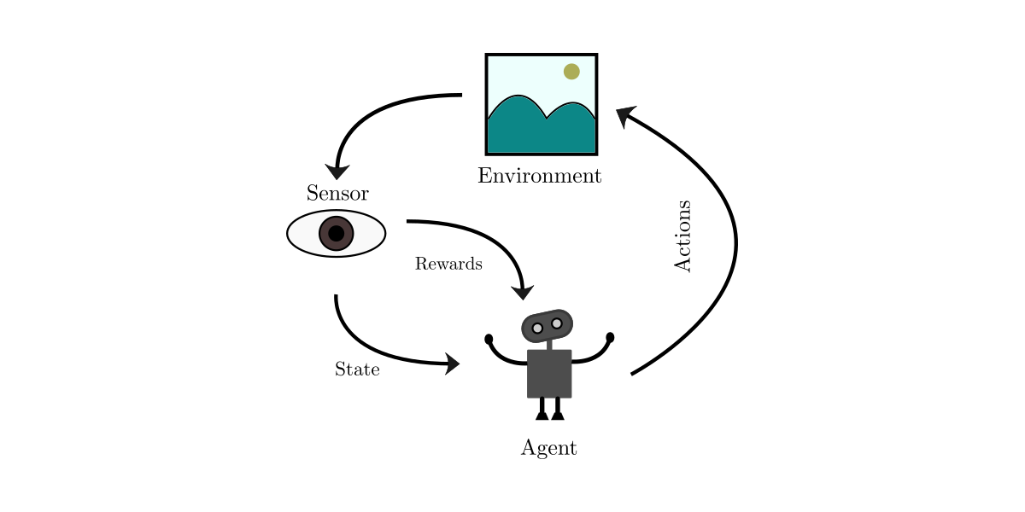

Slide 23
Applications of Machine Learning
Email filtering
Speech recognition,
Face recognition
Disease detection
Fraud detection
Computer vision,
Self-driven cars
Weather Forecasting
NLP
Amazon product recommendation, etc.

Slide 24
Issues in Machine Learning
Healthcare,
Education,
Finance,
Automobile,
Marketing, Shipping,
Infrastructure,
Automation, etc.
Big companies like Amazon
Facebook,
Google
Adobe, etc.
But everything in this world has bright as well as dark sides.

Slide 25
Issues in Machine Learning
1. Inadequate Training Data
Noisy Data- It is responsible for an inaccurate prediction that affects the decision as well as accuracy in classification tasks.
Incorrect data- It is also responsible for faulty programming and results obtained in machine learning models. Hence, incorrect data may affect the accuracy of the results also.
2. Poor/ Lack of quality of data
3. Overfitting and Underfitting
4. Irrelevant features
Lack of Skilled Resources
Inadequate Infrastructure

Slide 26
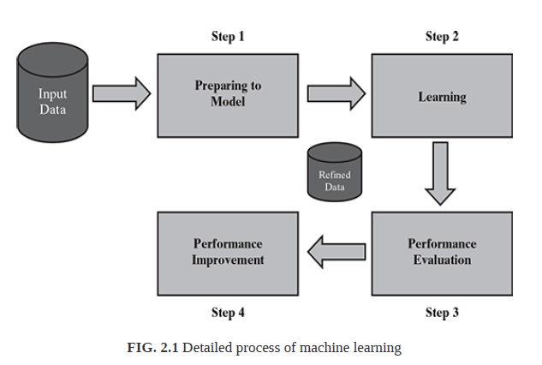

Slide 27
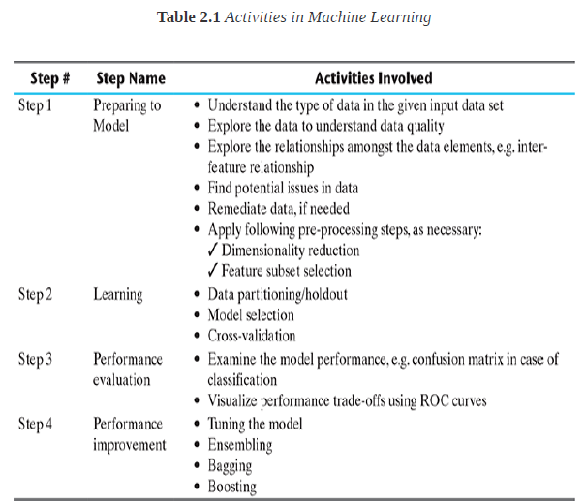

Slide 28
BASIC TYPES OF DATA IN MACHINE LEARNING
A dataset is a collection of related information or records.
The information may be on some entity or some subject area.
For example (Fig.2.2), we may have a data set on students in which each record consists of information about a specific student.
Again, we can have a dataset on student performance which has records providing performance.

Slide 29
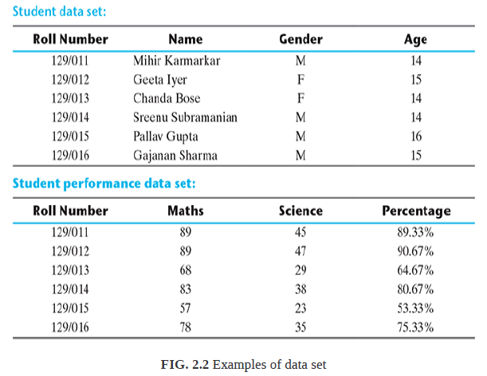

Slide 30
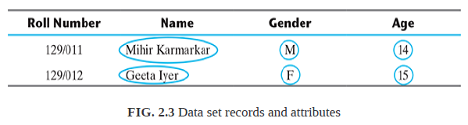
Each row of a data set is called a record.
Each data set also has multiple attributes, each of which gives information on a specific characteristic.
For example, in the dataset on students, there are four attributes.
Attributes can also be termed as feature, variable, dimension or field.
Both the datasets, Student and Student Performance, are having four features or dimensions; hence they are told to have four dimensional data space.

Slide 31
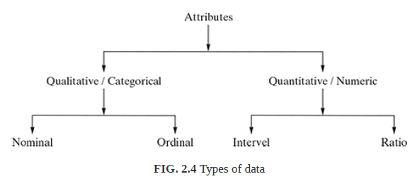
Types of Data in ML
Data can broadly be divided into following two types:
1. Qualitative data
2. Quantitative data

Slide 32
Qualitative data
Qualitative data provides information about the quality of an object or information which cannot be measured.
For example, if we consider the quality of students in terms of performance such as ‘Good’, ‘Average’, and ‘Poor’,
It falls under the category of qualitative data.
Also, name or roll number of students are information that cannot be measured using some scale of measurement. So they would fall under qualitative data.
Qualitative data is also called categorical data.
Qualitative data can be further subdivided into two types as follows:
1. Nominal data
2. Ordinal data

Slide 33
Nominal data
Nominal data is one which has no numeric value, but a named value.
It is used for assigning named values to attributes. Nominal values cannot be quantified.
Examples of nominal data are
1. Blood group: A, B, O, AB, etc.
2. Nationality: Indian, American, British, etc.
3. Gender: Male, Female, Other.
A special case of nominal data is when only two labels are possible, e.g. pass/fail as a result of an examination.
This sub-type of nominal data is called ‘dichotomous’.

Slide 34
Ordinal data
Ordinal data assigns named values to attributes but unlike nominal data, they can be arranged in a sequence of increasing or decreasing value so that we can say whether a value is better than or greater than another value.
Examples of ordinal data are
1. Customer satisfaction: ‘Very Happy’, ‘Happy’, ‘Unhappy’, etc.
2. Grades: A, B, C, etc.
3. Hardness of Metal: ‘Very Hard’, ‘Hard’, ‘Soft’, etc.
Like nominal data, basic counting is possible for ordinal data.
Hence, the mode can be identified. Since ordering is possible in case of ordinal data, median, and quartiles can be identified in addition.
Mean can still not be calculated.

Slide 35
Quantitative data
Quantitative data relates to information about the quantity of an object – hence it can be measured.
For example, if we consider the attribute ‘marks’, it can be measured using a scale of measurement.
Quantitative data is also termed as numeric data.
There are two types of quantitative data:
1. Interval data
2. Ratio data

Slide 36
Interval data
Interval data is numeric data for which not only the order is known, but the exact difference between values is also known.
An ideal example of interval data is Celsius temperature. The difference between each value remains the same in Celsius temperature.
For example, the difference between 12°C and 18°C degrees is measurable and is 6°C as in the case of difference between 15.5°C and 21.5°C. Other examples include date, time, etc.
For interval data, mathematical operations such as addition and subtraction are possible. For that reason, for interval data, the central tendency can be measured by mean, median, or
mode. Standard deviation can also be calculated.
However, interval data do not have something called a ‘true zero’ value.
For example, there is nothing called ‘0 temperature’ or ‘no temperature’. Hence, only addition and subtraction applies for interval data. The ratio cannot be applied. This means, we can say a temperature of 40°C is equal to the temperature of 20°C + temperature of 20°C.
However, we cannot say the temperature of 40°C means it is twice as hot as in temperature of 20°C.

Slide 37
Ratio data
Ratio data represents numeric data for which exact value can be measured.
Absolute zero is available for ratio data.
Also, these variables can be added, subtracted, multiplied, or divided.
The central tendency can be measured by mean, median, or mode and methods of dispersion such as standard deviation.
Examples of ratio data include height, weight, age, salary, etc.

Slide 38
Apart from the approach detailed above, attributes can also be categorized into types based on a number of values that can be assigned.
The attributes can be either discrete or continuous based on this factor.
Discrete attributes can assume a finite or countably infinite number of values. Nominal attributes such as roll number, street number, pin code, etc. can have a finite number of values whereas numeric attributes such as count, rank of students, etc. can have countably infinite values.
A special type of discrete attribute which can assume two values only is called binary attribute. Examples of binary attribute include male/ female, positive/negative, yes/no, etc.
Continuous attributes can assume any possible value which is a real number. Examples of continuous attribute include length, height, weight, price, etc.
In general, nominal and ordinal attributes are discrete.
On the other hand, interval and ratio attributes are continuous, barring a few exceptions, e.g. ‘count’ attribute.

